Slide 1

Project Seminar on
Quantitative Analysis
In Supply Chain using ML
in partial fulfillment of
VII Semester Bachelor of Engineering (B.E.)
in
Electronics Engineering
Yashwant Lalwani (A-38)
Jai Sood(A-70)
Ayaan Pasha (B-17)
Mohammad Hisham (B-25)
Guided by
Prof. Archana Tiwari
Co-Guided by
Mr. Akash Kirtane
Web Beta Pvt Ltd
Department of Electronics Engineering
Shri Ramdeobaba College of Engineering and Management,
Ramdeo Tekadi, Gittikhadan, Katol Road, Nagpur 440013, India.
Session 2023-24

Slide 2
Introduction
Supply Chain
Supply chain and supply chain management are essential concepts for any business that produces or delivers goods or services. A supply chain is the network of activities, resources, and entities involved in the creation and distribution of a product or service, from the raw materials to the final customer.
Supply chain management
Supply chain management is the process of planning, coordinating, and controlling the flow of materials, information, and finances along the supply chain, in order to optimize efficiency, quality, and customer satisfaction.

Slide 3
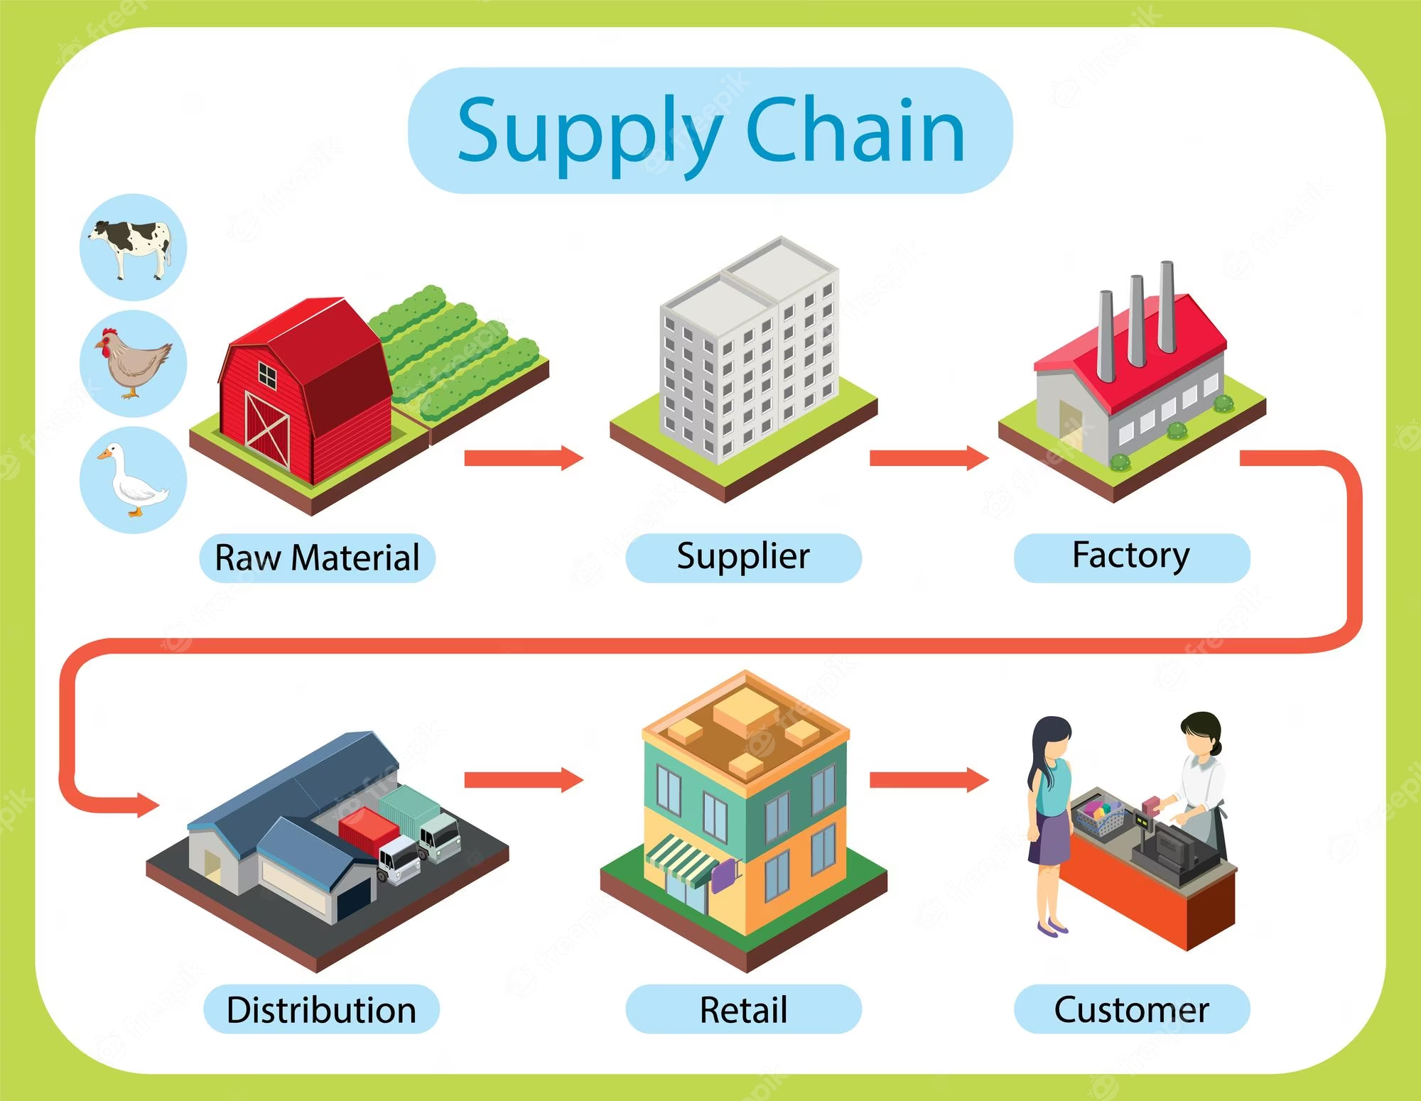

Slide 4
How can ML help in Supply Chain Mgmt.
Network optimization
Transportation and logistics optimization
Supplier selection and evaluation
Data-driven decision-making
Warehouse management
.

Slide 5
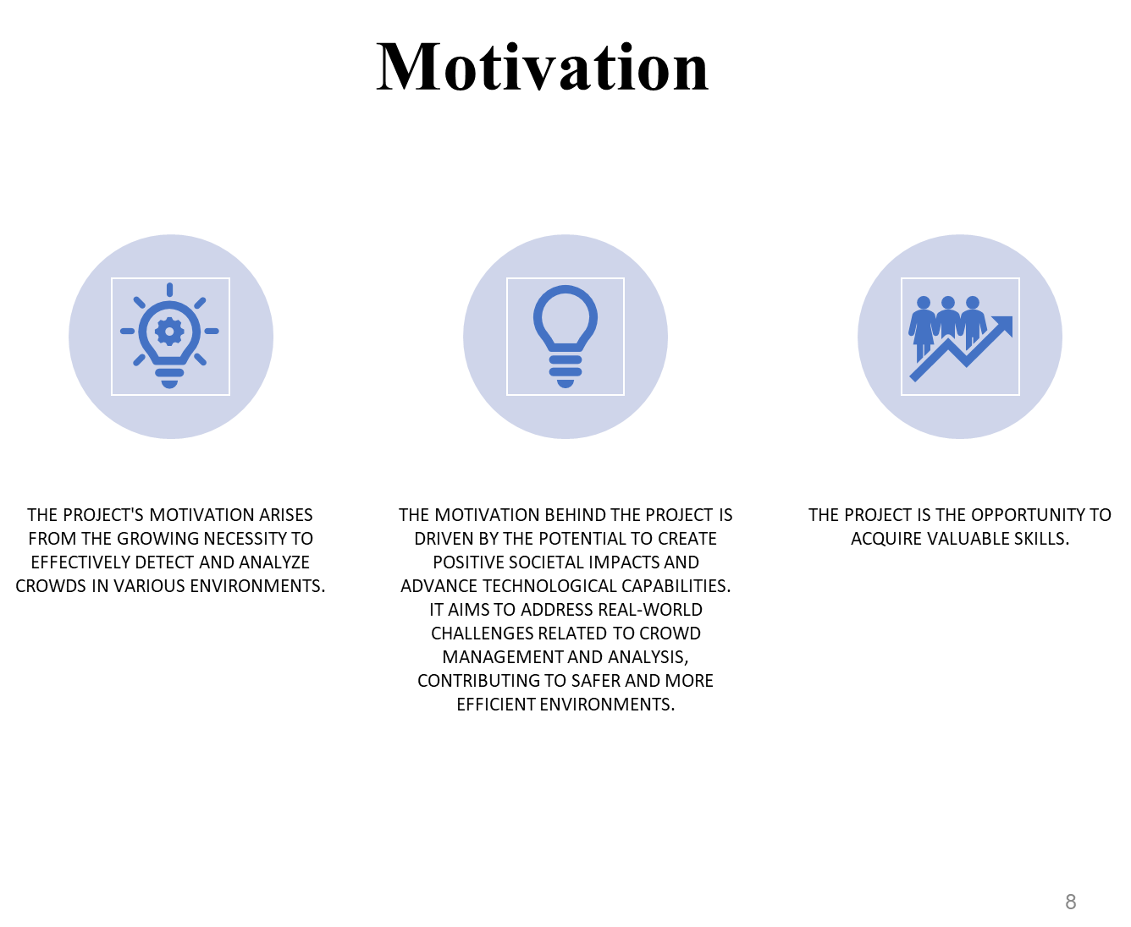
Cost Reduction
Optimization techniques minimize costs associated with inventory, transportation, and other supply chain elements, leading to significant cost savings
Resource Allocation: Quantitative analysis aids in the optimal allocation of resources, such as labor, equipment, and warehouse space.
Strategic Decision Support Quantitative analysis assists in making strategic supply chain decisions, such as network design and expansion planning.

Slide 6
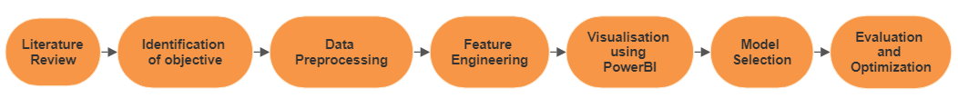
Methodology

Slide 7
Data Preprocessing
Data Preprocessing:
Data preprocessing serves as the bedrock of our project, ensuring data cleanliness, consistency, and readiness for analysis.
Tasks in Data Preprocessing:
Data Cleaning: It involves addressing missing values, correcting errors, and handling outliers to preserve data integrity.
Data Transformation: This task converts data into suitable formats, scales numerical values, and encodes categorical variables.
Data Integration: By merging and aligning data from diverse sources, we create a comprehensive dataset.
Data Reduction: The process involves reducing dataset size through feature selection or data point aggregation, optimizing processing efficiency.

Slide 8
Feature Engineering
Feature Engineering:
Feature engineering elevates our dataset, enabling it to capture intricate patterns and relationships.
Phases of Feature Engineering:
Feature Selection: This phase identifies and retains the most relevant features, contributing significantly to the problem.
Feature Creation: By crafting new features through combinations or transformations, hidden insights come to light.
Dimensionality Reduction: Reducing the number of features simplifies the dataset, enhancing model performance.

Slide 9
Visualization with Power BI
Visualization with Power BI:
Effective data visualization is pivotal in making complex findings comprehensible to stakeholders.
Objectives of this Phase:
Dashboard Creation: Interactive dashboards present vital supply chain metrics, trends, and predictions.
Data Storytelling: Visualizations convey project findings and their implications effectively.
Real-time Insights: Integration of real-time data feeds into Power BI ensures up-to-the-minute supply chain visibility.

Slide 10
Author | Journal | Year | Key Findings
Saeid Sadeghi, Farzaneh Mansoori Mooseloo, Hadi Rezaei Vandchali | Application of Machine Learning in Supply Chain Management | 2021 | -Competitive forces, IT revolution, globalization, and customer expectations emphasize competition among supply chains over individual companies. -Big data generated in various industries is a valuable asset for process optimization, control and design. -Big data analytics, IoT, blockchain, and advanced deep learning can provide real-time insights, enhance transparency, and enable informed decisions in SCM
Real Carbonneau, Kevin Laframboise, Rustam Vahidov | Application of machine learning techniques for supply chain demand forecasting | 2008 | -The analysis uses data from two sources: a simulated extended supply chain and the estimated value of new orders received by Canadian foundries. -The introduction of inaccurate information into supply chain systems can further contribute to demand distortion
Haifeng Lin, Ji Lin, Fang Wang | An innovative machine learning model for supply chain management | 2022 | -efficient supply chain management is essential for economic success, requiring the seamless flow of information, money, logistics, and resources. -proposed method aids in clustering candidate partners and identifying suitable types of enterprises for collaboration, supporting supply chain decision-makers in logistics planning.

Slide 11
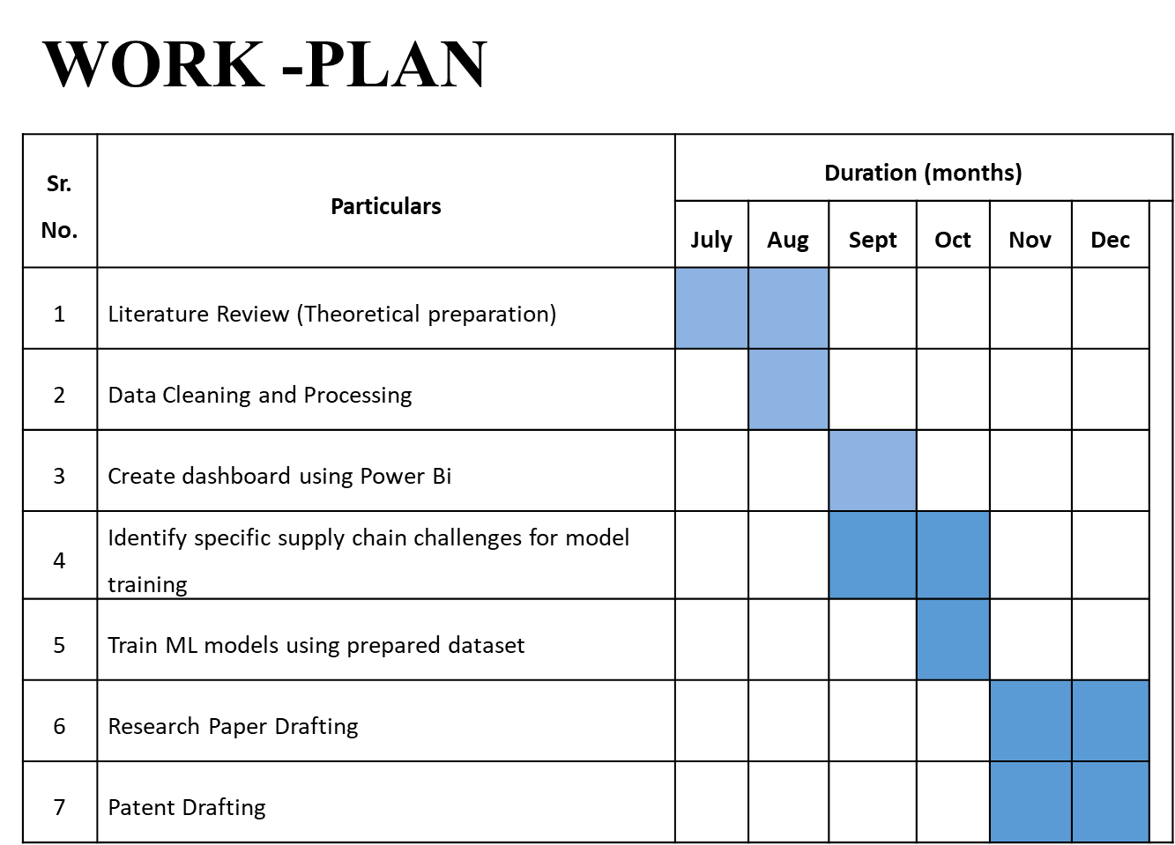

Slide 12
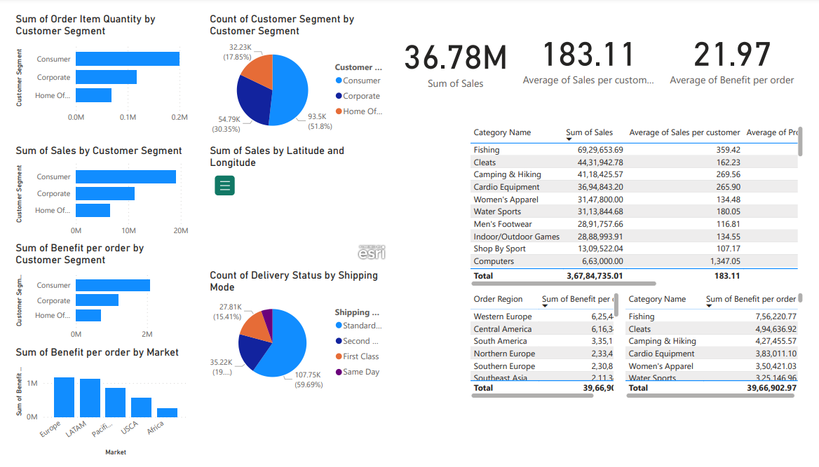
Dashboard Using Power BI(Phase-I Results)

Slide 13
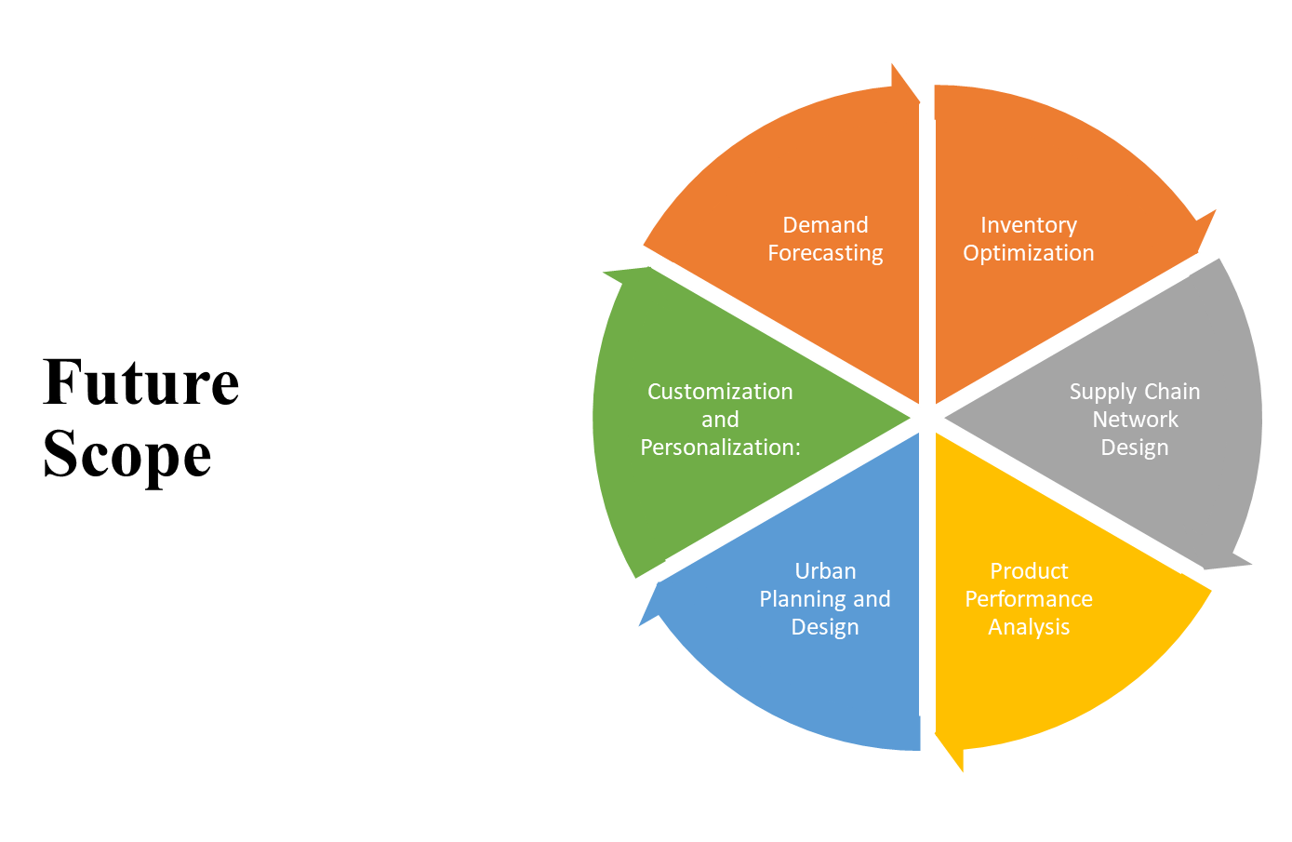

Slide 14
REFERENCES
Marler, R. T., & Gao, Y. “Literature review—machine learning in supply chain management.” Computers & Industrial Engineering, 101,13-21, 2016.
Verma, R., & Pulli, K. “Supply Chain Optimization using Machine Learning Techniques.” Procedia Computer Science, 152, 241-247, 2019.
Wagner, S. M., & Bode, C. “An empirical examination of supply chain performance along several dimensions of risk.” Journal of Business Logistics, 27(1), 41-64, 2016.
Saeid Sadeghi, Farzaneh Mansoori Mooseloo, Hadi Rezaei Vandchali. “Application of Machine Learning in Supply Chain Management.” Department of Industrial Engineering, 2021.
Link: Application of Machine Learning in Supply Chain Management: A Comprehensive Overview of the Main Areas (hindawi.com)
Real Carbonneau, Kevin Laframboise, Rustam Vahidov. “Application of machine learning techniques for supply chain demand forecasting,” Department of Decision Sciences & MIS, John Molson School of Business, 2008; Link: Application of machine learning techniques for supply chain demand forecasting - ScienceDirect
Haifeng Lin, Ji Lin, Fang Wang. “ An innovative machine learning model for supply chain management.” College of Information Science and Technology, College of Electronic Engineering, 2022; Link: An innovative machine learning model for supply chain management - ScienceDirect

Slide 15
Thank You

